Slide 1


HireMe.com
An online study help website for university students

Slide 2
Background
This is a
VUE CLI project
Which include,
HTML,CSS
Vue.js
Vuetify - is a package which implement the martial design for Vue.js components

Slide 3
How to set-up
How to Run
$ npm install -g vue-cli
$ vue create <app-name>
$ cd <app-name>
$ npm install
$ npm install vuetify
$ npm run dev

Slide 4
Aim/Target Audience:
Online study help provider for university students.
Link to source code: https://github.com/pwarnaku/sit120
Vuetify : https://vuetifyjs.com/en/

Slide 5

Home Page

Slide 6
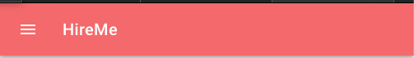
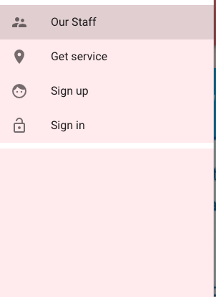

Slide 7
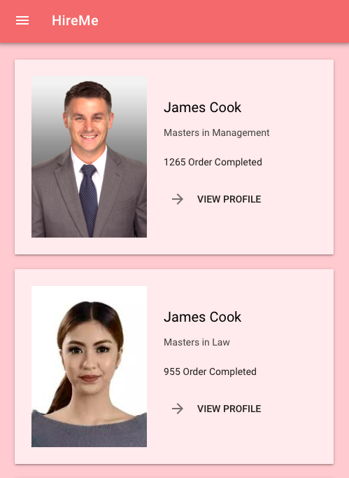
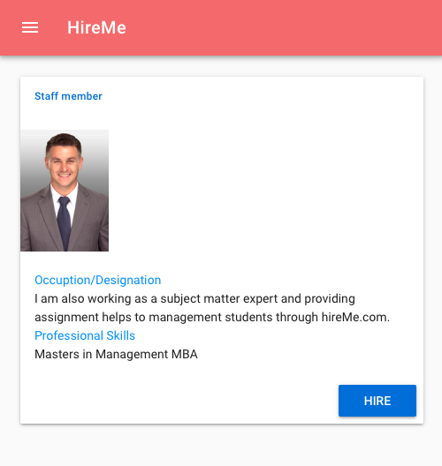
Staff Profile

Slide 8
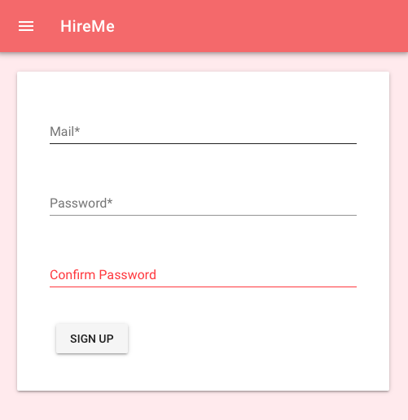
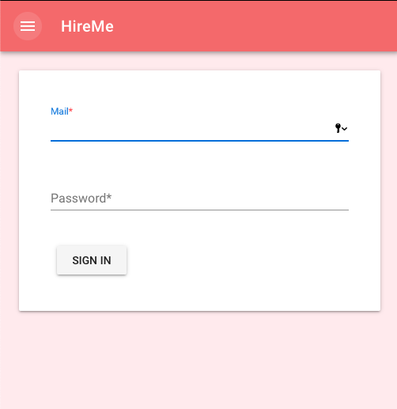
Forms

Slide 9


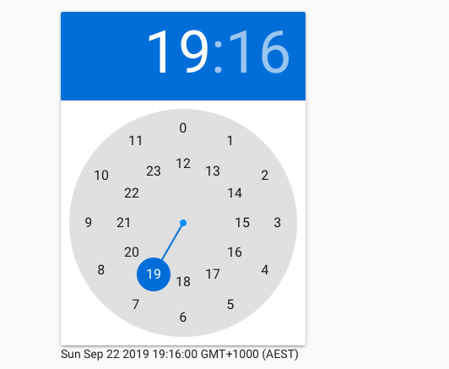
Forms Cont.

Slide 10
Thank you

